Slide 1

Introduction to Cloud Computing
Week 14
Capacity Planning and Load Balancing
CS-4037
Muhammad Sudais
muhammad.sudais.v@nu.edu.pk

Slide 2
CHAPTER 10 Capacity Planning
|Cloud Computing

Slide 3
Introduction
What is Capacity Planning?
It is a strategy to ensure that resources are sufficient to meet demand while minimizing costs.
Goals:
Meet current and future service demands.
Avoid resource wastage and underutilization.
Critical for maintaining system performance and controlling costs.

Slide 4
Evolution of Capacity Planning
Traditional Approach:
Resources were provisioned for peak demand, leading to wastage and inflated budgets.
Siloed resource management with limited stakeholder involvement.
Cloud-Based Approach:
Eliminates silos through multi-tenancy and resource sharing.
Users can self-provision resources dynamically.

Slide 5
The Illusion of Infinite Resources
Cloud services create the impression of unlimited resources through:
Resource virtualization.
Auto-scaling mechanisms.
However, physical limitations exist at the data center level.
Proper capacity planning prevents resource shortages and unexpected costs.
Capacity Planning Across Cloud Service Layers

Slide 6
Capacity Planning Across Cloud Service Layers: Responsibility Distribution
IaaS Providers:
Handle physical resource planning.
Monitor consumer requirements via Service Level Agreements (SLAs).
PaaS Providers:
Manage virtual resources or rely on IaaS providers.
SaaS Providers:
Plan capacity based on consumer needs and SLAs.
Consumer Roles in Capacity Planning
Consumers must estimate and communicate resource needs to service providers.
Inaccurate estimations may result in higher costs due to dynamic billing models.

Slide 7
Multi-Layer Capacity Planning
Company A (IaaS Provider): Provides physical infrastructure.
Company B (PaaS Provider): Builds platforms on IaaS resources & Plans additional virtual servers to handle spikes.
Company C (SaaS Provider): Offers applications to end-users and relies on PaaS for capacity.
End Users: Estimate needs or pass responsibility to the SaaS provider.

Slide 8
Strategies for Effective Capacity Planning
Data Collection: Analyze consumer behavior and application usage patterns.
Dynamic Resource Management: Use auto-scaling to meet fluctuating demands.
Collaboration: Ensure communication across layers (SaaS, PaaS, IaaS).
SLAs: Define responsibilities and capacity requirements clearly.

Slide 9
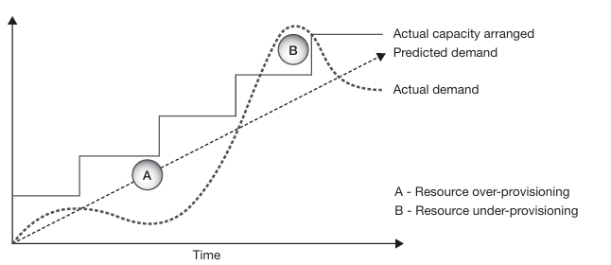
Capacity Planning: Then and Now
Traditional Fixed Cost Computing Model:
Fixed Investment: Organizations allocated resources for several years based on average demand estimations, leading to two main issues:
Over-Provisioning (A): Excess resources during low demand resulted in wastage of capacity and investment.
Under-Provisioning (B): Insufficient resources during peak demand led to degraded performance and lost revenue opportunities.
Resource Wastage: Idle resources in low-demand periods increased costs.

Slide 10
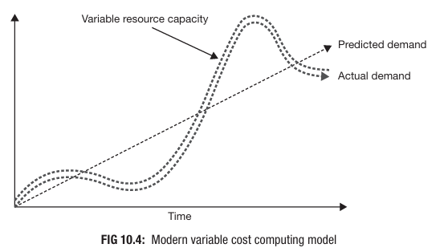
Capacity Planning: Then and Now
Modern Variable Cost Computing Model:
Pay-Per-Use: Cloud computing allows dynamic resource provisioning where organizations rent resources as needed.
Dynamic Scaling: Resources align closely with demand, reducing waste and ensuring performance during spikes.
Efficiency Gains: Multi-tenancy in cloud environments allows providers to balance resource allocation across clients, improving overall utilization.

Slide 11
Approaches to Maintaining Sufficient Capacity
Traditional Approach with N+1 Rule
Redundancy: Organizations provision N+1 nodes (one extra) to handle unexpected spikes or node failures.
Limitations: Static in nature and can still result in over-provisioning or delays during unexpected surges.
Cloud-Specific Approach
Auto-Scaling: Automatically adjusts resources to meet demand, reducing the burden on capacity planners.
Flexibility: Cloud providers manage infrastructure using virtual resources, which scale based on usage patterns.

Slide 12
Role of Auto-Scaling
Efficiency: Multi-tenancy allows resource pooling, where unused capacity from one application can be reallocated to another.
Responsiveness: Auto-scaling minimizes idle resources while ensuring availability during peaks.
Challenges: While useful, lazy design can lead to reliance on auto-scaling without proper capacity planning.

Slide 13
Capacity vs. Performance
Capacity Planning: Focuses on ensuring future resource availability to handle workloads effectively.
Performance Optimization: Aims to maximize output with existing resources, enhancing system efficiency.

Slide 14
Steps for Effective Capacity Planning
Determine Expected Demand:
Analyze demand patterns (hourly, daily, weekly, yearly).
Use historical data or expert assumptions for new applications.
Identify correlations between spikes and business events (e.g., product launches).
Analyze Current Response to Load:
Measure resource loads (processor, memory, storage, network).
Identify stress points through testing.
Know the System's Value:
Assess the cost-benefit of adding capacity.
Focus on balancing investment with performance gains.
Example: Workload Trends
Daily/Yearly Graphs: Analyze traffic spikes and averages to anticipate demand variability.
Unexpected Peaks: Plan for predictable demand and respond to deviations dynamically.

Slide 15
CHAPTER 11 Load Balancing
|Cloud Computing

Slide 16
Introduction
What is Load Balancing:
Distributes workloads evenly across computing resources.
Ensures no single resource is overloaded.
Improves performance, reliability, and scalability.
Importance of Load Balancing in Cloud Computing
Optimization: Maximizes resource utilization and throughput.
Scalability: Enables dynamic resource provisioning.
Reliability: Reduces risk of total system failure.
Flexibility: Supports distributed cloud architecture.
Key Objectives of Load Balancing
Optimize resource utilization.
Minimize response time.
Avoid resource overloading.
Maintain uninterrupted service.

Slide 17
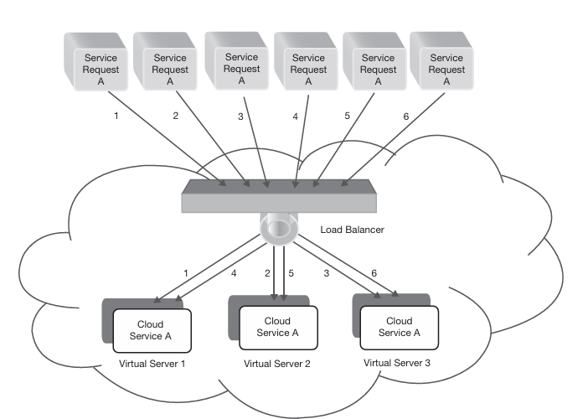
Load Balancing Architecture
Load balancer acts as an abstraction layer over resources.
Front-end node: Distributes requests to back-end nodes.
Back-end nodes: Virtual machines and physical servers process requests.
Types of Load Balancing
Hardware-based: Multi-layer switch systems (expensive but efficient).
Software-based: Domain Name System (DNS) servers (cost-effective and flexible).

Slide 18
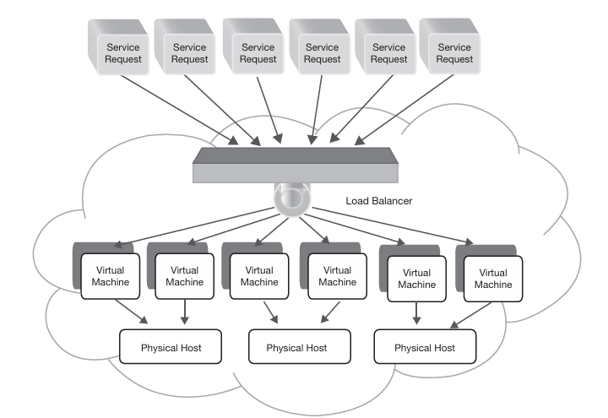
Levels of Load Balancing
VM Provisioning: Allocates service requests to virtual machines.
Resource Provisioning: Maps requests to physical resources.

Slide 19
Components of Load Balancing
What we can use for load balancing:
Application server instances (CPU, memory).
Storage resources.
Network switches.
Core services: DNS, TCP, HTTP/HTTPS.

Slide 20
Challenges of Load Balancing
Implementation complexity.
Maintaining performance during high traffic.
Adapting to unpredictable workload patterns.

Slide 21
Goals of Load Balancing
Load balancing ensures the efficient distribution of workloads across computing resources in cloud systems. Key objectives include:
Improving System Performance
Prevents resource overloading while others remain underutilized.
Maintains a stable and high-performing system with balanced load distribution.
Maximizing Fault Tolerance
Enhances system resilience by redirecting traffic from failed nodes to functional ones.
Ensures uninterrupted user experience despite node failures.
Accommodating Scaling
Supports system growth or shrinkage by redistributing workloads accordingly.
Adjusts load among new nodes or scales down without affecting performance.
Ensuring Application Availability
Prevents application downtime by routing traffic to less-utilized nodes.
Enhances overall application reliability.

Slide 22
Categories of Load Balancing
Static Approach:
Distributes loads based on predefined rules without considering the system's current state.
Uses algorithms like Round Robin and Weighted Round Robin.
Dynamic Approach:
Uses feedback from resources to distribute loads dynamically based on real-time conditions.
Actively monitors resource statuses.
Redirects traffic if a node fails or becomes overloaded.

Slide 23
Dynamic Load Balancing
Dynamic load balancing can be implemented in the following ways:
Distributed Approach: All nodes share the load-balancing responsibility.
Cooperative: Nodes work together to achieve a common goal (e.g., response time improvement).
Non-Cooperative: Nodes operate independently to meet local objectives.
Non-Distributed Approach: Managed by one or a cluster of central nodes.
Centralized: A single node controls all load balancing but risks bottlenecks and single points of failure.
Semi-Distributed: A cluster of nodes divides tasks, with each cluster operating in a centralized manner.

Slide 24
Parameters for Load Balancing
Resource Utilization
Ensures even distribution of workloads to avoid overloading any single resource.
Response Time
Minimizes the delay in handling service requests to enhance user experience.
System Health
Monitors and manages node failures to maintain system efficiency.
Associated Overhead
Reduces inter-node communication and task movement to optimize performance.
Scalability
Supports system expansion or reduction based on application demands.

